Slide 1
Modeling Human Workload in Unmanned Arial Systems
Mike Goodrich, and Eric Mercer
Brigham Young University

Slide 2
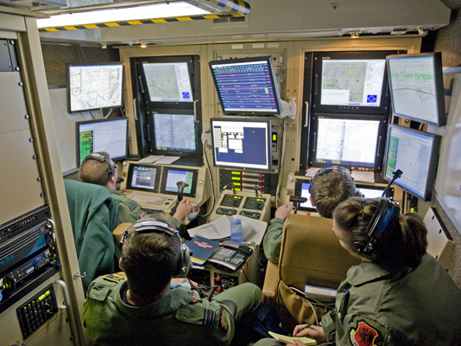

Slide 3
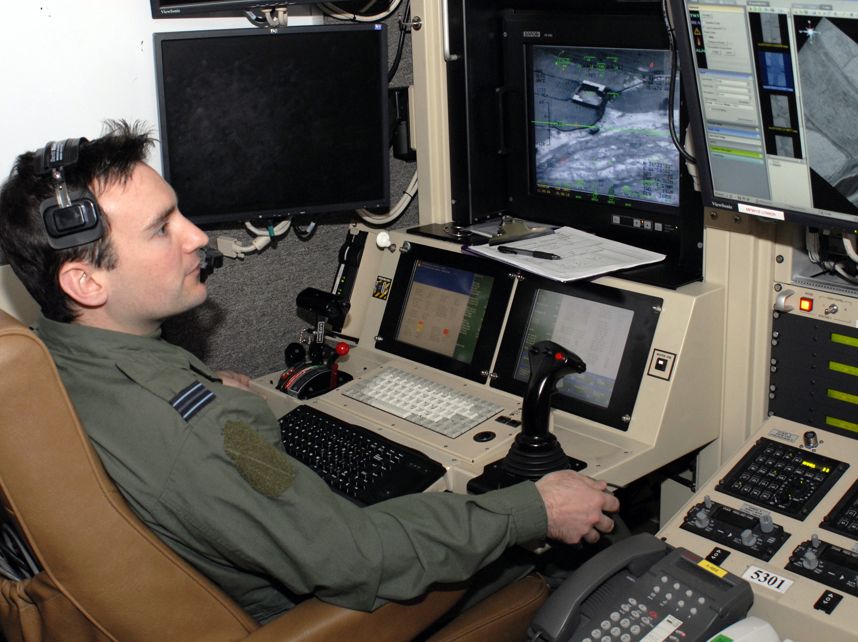

Slide 4
How can we reduce the number of operators and manage workload through better interfaces and increased autonomy?

Slide 5
Summary of Past Work and Technical Approach

Slide 6
Directed Team Graph
Visual
Bob
Audio
Alice
Visual
Audio
Notes:
Everything schedules on the event simulator.

Slide 7
Discrete Event Simulator
Visual
Bob
Audio
Alice
Visual
Audio
Events
Update on Event
Events
Discrete Event
Simulator
Notes:
Everything schedules on the event simulator.

Slide 8
Directed Role Graph
Memory
DESIRE = 10
Vo
Bob
Ao
c1
Vi
IDLE
WAVE
Ai
c2
c4
c3
SPEAK
Notes:
Everything schedules on the event simulator.

Slide 9
Tabular Form
PS | INPUT | MEM | NS | OUTPUT | MEM | Pr | Delay | Pb
IDLE |  | DESIRE>5 | WAVE | Vo=WAVE |  |  | [2-5] | 95%
IDLE |  | DESIRE<=5 | IDLE |  | DESIRE++ |  | [5-10]
WAVE | Vi=WAVE |  | SPEAK | Ao=HELLO | DESIRE++ | 1 | [2-5]
WAVE |  |  | IDLE | Vo=SAD | DESIRE-- | 2 | [5-10]
SPEAK | Ai=HELLO |  | IDLE |  | DESIRE-- |  | [2-5]
PS | INPUT | MEM | NS | OUTPUT | MEM | Pr | Delay | Pb
IDLE | Vi=WAVE | APATHY<5 | WAVE | Vo=WAVE |  |  | [2-5] | 70%
IDLE | Vi=WAVE | APATHY>=5 | IDLE |  | APATHY-- |  | [2-5]
WAVE | Ai=HELLO |  | IDLE | Ao=HELLO | APATHY++ | 1 | [2-5]
Notes:
Add non-determinism in the enabled events in each actor so they have a choice. That models decisions workload.
All enabled transitions are sent to the simulator. It resolves the choice on priority first, and the coin-flip if tie (or order of appearance in the table)’
If you post the same transition, then the simulator sticks with it. If you post a new transition, then the simulator replaces your scheduled transition with the new transition.
You can create models which loop infinitely without firing any transition (zeno or shrondingers cat problem)

Slide 10
DESIRE = 5
APATHY = 5
PS
IDLE
WAVE
SPEAK
IDLE
Bob
V_{o}
WAVE
A_{o}
HELLO
PS
IDLE
WAVE
IDLE
Alice
V_{o}
WAVE
A_{o}
HELLO

Slide 11
Workload
Temporal
Cognitive
Perceptual

Slide 12
Workload
Temporal
Perceptual
Cognitive
Notes:
Metaphor: job shop
Constraints: order, which comes first, deadlines
Operation Tempo: pacing and completion of tasks over time
Fan-out: task neglect and required interaction time

Slide 13
Temporal Workload in Model
PS
IDLE
WAVE
SPEAK
Bob
V_{o}
WAVE
A_{o}
HELLO
PS
IDLE
WAVE
IDLE
Alice
V_{o}
WAVE
A_{o}
HELLO
6 fired transitions
Notes:
Largely a measure of operation tempo: Sliding window that counts transitions

Slide 14
Temporal Workload in Model
PS
IDLE
WAVE
SPEAK
Bob
V_{o}
WAVE
A_{o}
HELLO
PS
IDLE
WAVE
IDLE
Alice
V_{o}
WAVE
A_{o}
HELLO
4 fired transitions
Notes:
Largely a measure of operation tempo: Sliding window that counts transitions

Slide 15
Temporal Workload in Model
PS
IDLE
WAVE
SPEAK
Bob
V_{o}
WAVE
A_{o}
HELLO
PS
IDLE
WAVE
IDLE
Alice
V_{o}
WAVE
A_{o}
HELLO
4 fired transitions
Notes:
Largely a measure of operation tempo: Sliding window that counts transitions

Slide 16
Temporal Workload in Model
PS
IDLE
WAVE
SPEAK
Bob
V_{o}
WAVE
A_{o}
HELLO
PS
IDLE
WAVE
IDLE
Alice
V_{o}
WAVE
A_{o}
HELLO
6 fired transitions
Notes:
Largely a measure of operation tempo: Sliding window that counts transitions

Slide 17
Temporal Workload in Model
PS
IDLE
WAVE
SPEAK
Bob
V_{o}
WAVE
A_{o}
HELLO
PS
IDLE
WAVE
IDLE
Alice
V_{o}
WAVE
A_{o}
HELLO
6 fired transitions
Notes:
Largely a measure of operation tempo: Sliding window that counts transitions

Slide 18
Temporal Workload in Model
PS
IDLE
WAVE
SPEAK
Bob
V_{o}
WAVE
A_{o}
HELLO
PS
IDLE
WAVE
IDLE
Alice
V_{o}
WAVE
A_{o}
HELLO
6 fired transitions
Notes:
Largely a measure of operation tempo: Sliding window that counts transitions

Slide 19
Temporal Workload in Model
PS
IDLE
WAVE
SPEAK
Bob
V_{o}
WAVE
A_{o}
HELLO
PS
IDLE
WAVE
IDLE
Alice
V_{o}
WAVE
A_{o}
HELLO
8 fired transitions
Notes:
Largely a measure of operation tempo: Sliding window that counts transitions

Slide 20
Workload
Temporal
Cognitive
Perceptual
Notes:
Metaphor: computer hardware
Parallel: Using multiple channels simultaneously such as visual and audio. Or visual, audio, and haptic.
Sequential: Doing one thing at a time in series.
Multi-threaded: Channel conflict—two audio sources both active

Slide 21
Cognitive Workload in Model
PS
IDLE
WAVE
SPEAK
Bob
V_{o}
WAVE
A_{o}
HELLO
PS
IDLE
WAVE
IDLE
Alice
V_{o}
WAVE
A_{o}
HELLO
0 Active Inputs
Notes:
Count the number of active inputs at each point in time (every output is an input somewhere). Only count at the interface of certain actors.

Slide 22
Cognitive Workload in Model
PS
IDLE
WAVE
SPEAK
Bob
V_{o}
WAVE
A_{o}
HELLO
PS
IDLE
WAVE
IDLE
Alice
V_{o}
WAVE
A_{o}
HELLO
1 Active Inputs

Slide 23
Cognitive Workload in Model
PS
IDLE
WAVE
SPEAK
Bob
V_{o}
WAVE
A_{o}
HELLO
PS
IDLE
WAVE
IDLE
Alice
V_{o}
WAVE
A_{o}
HELLO
1 Active Inputs

Slide 24
Cognitive Workload in Model
PS
IDLE
WAVE
SPEAK
Bob
V_{o}
WAVE
A_{o}
HELLO
PS
IDLE
WAVE
IDLE
Alice
V_{o}
WAVE
A_{o}
HELLO
1 Active Inputs

Slide 25
Cognitive Workload in Model
PS
IDLE
WAVE
SPEAK
Bob
V_{o}
WAVE
A_{o}
HELLO
PS
IDLE
WAVE
IDLE
Alice
V_{o}
WAVE
A_{o}
HELLO
1 Active Inputs

Slide 26
Cognitive Workload in Model
PS
IDLE
WAVE
SPEAK
Bob
V_{o}
WAVE
A_{o}
HELLO
PS
IDLE
WAVE
IDLE
Alice
V_{o}
WAVE
A_{o}
HELLO
1 Active Inputs

Slide 27
Cognitive Workload in Model
PS
IDLE
WAVE
SPEAK
Bob
V_{o}
WAVE
A_{o}
HELLO
PS
IDLE
WAVE
IDLE
Alice
V_{o}
WAVE
A_{o}
HELLO
2 Active Inputs

Slide 28
Cognitive Workload in Model
PS
IDLE
WAVE
SPEAK
Bob
V_{o}
WAVE
A_{o}
HELLO
PS
IDLE
WAVE
IDLE
Alice
V_{o}
WAVE
A_{o}
HELLO
2 Active Inputs

Slide 29
Workload
Temporal
Cognitive
Perceptual
Notes:
Metaphor: artificial intelligence
Perceive, think, act: finding the solution is often harder than executing the solution (perceive and think matter)
Algorithmic Complexity: Executing the solution may take time.

Slide 30
Algorithmic Workload in Model
PS
IDLE
WAVE
SPEAK
IDLE
Bob
V_{o}
WAVE
A_{o}
HELLO
PS
IDLE
WAVE
IDLE
Alice
V_{o}
WAVE
A_{o}
PS | INPUT | MEM | NS | OUTPUT | MEM | Pr | Delay | Pb
IDLE | Ai=HELLO |  | SPEAK | Vo=WAVE |  |  | [2-5] | 70%
IDLE | Ai=HELLO |  | IDLE |  | APATHY-- |  | [2-5]
2 Enabled Transitions
Notes:
Abstracts Perceive. There are two choices. A little strange all the same though since the simulator makes the final selection (randomly) when it is not resolved by priority.

Slide 31
Algorithmic Workload in Model
PS
IDLE
IDLE
Bob
V_{o}
A_{o}
PS
IDLE
Alice
V_{o}
A_{o}
Working over 5 time units
Nothing Fired
Notes:
Crude abstraction of algorithmic complexity. It took some amount of time to be ready to fire a transition.
Increment a counter in each time bucket if an actor is working. Otherwise leave it alone.
Must measure per-actor back from fired transition over the duration.

Slide 32
Algorithmic Workload in Model
PS
IDLE
WAVE
Bob
V_{o}
WAVE
A_{o}
PS
IDLE
Alice
V_{o}
A_{o}
Working over 2 time units
Nothing Fired
Notes:
Crude abstraction of algorithmic complexity. It took some amount of time to be ready to fire a transition.

Slide 33
Algorithmic Workload in Model
PS
IDLE
WAVE
IDLE
Bob
V_{o}
WAVE
SAD
A_{o}
PS
IDLE
IDLE
Alice
V_{o}
A_{o}
Nothing Fired
Working over 3 time units
Notes:
It is a causal relationship.

Slide 34
Algorithmic Workload in Model
PS
IDLE
WAVE
IDLE
Bob
V_{o}
WAVE
SAD
A_{o}
PS
IDLE
WAVE
Alice
V_{o}
WAVE
A_{o}
Nothing Fired
Working over 2 time units
Notes:
Once a transition fires, it looks back and marks where it was working.

Slide 35
Resolving Non-determinism
Many Executions
Java Pathfinder
Non-Deterministic Model

Slide 36
Finding Workload Extremes
Instantaneous
Workload
Cumulative Workload
Time
Find Paths that Max/Min Cumulative Workload

Slide 37
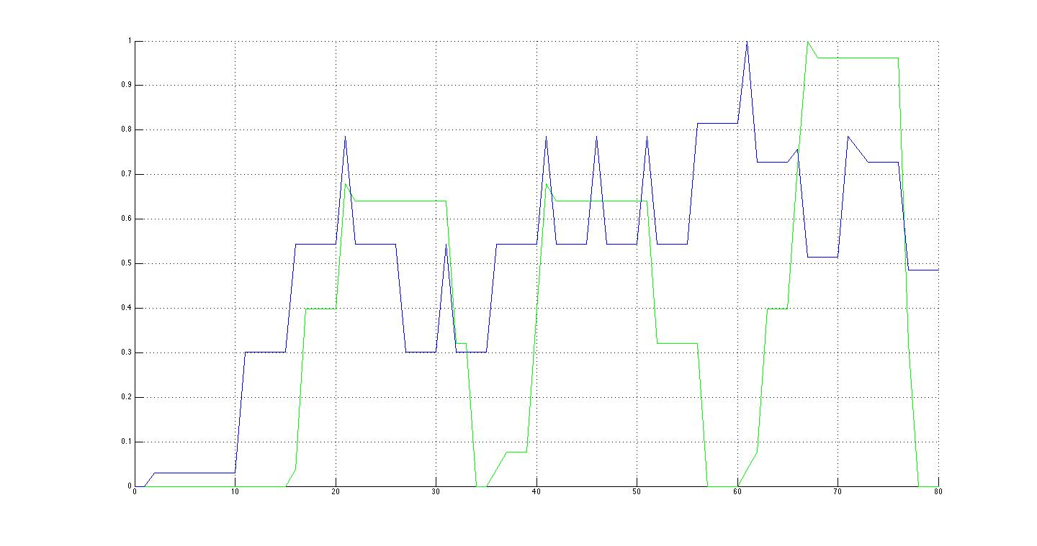
Bob and Alice Individual Workloads
Bob
Alice
Hello
Sad
Waving
Replace with new plots!
Notes:
Bob is Blue and Alice is green.
At 10 - Bob can both increase his desire or wave(he decides to wave)
At 15 - bob waves, Alice decides to decreases apathy
At 20 - Bob goes to sad then increases desire
35 - bob waves again
40 - alice waves, bob doesn't see and goes sad
55 they see each other wave and begin talking
75 - conversation ends
REPLACE THIS WITH NEW PLOTS!

Slide 38
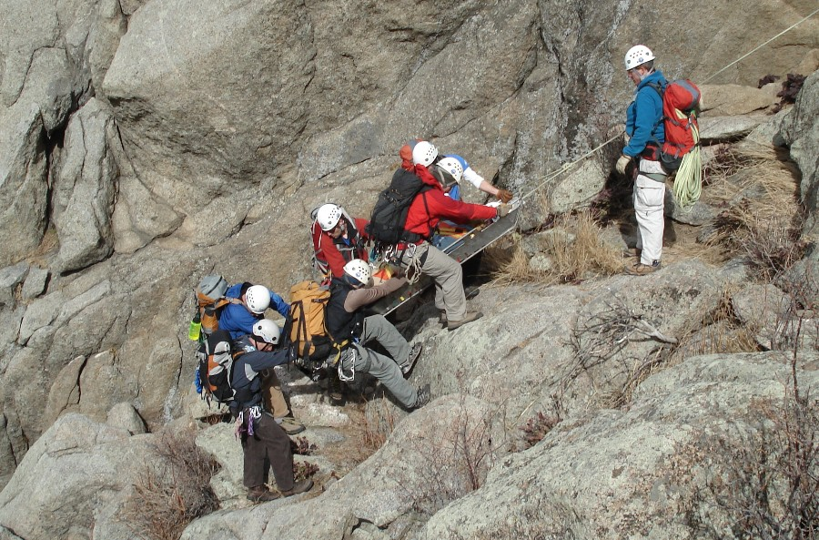
WiSAR

Slide 39
WiSAR Team Graph
Events
Mission Manager
V
Payload Operator
V
A
A
Payload
GUI
D
UAV
I
V
Incident Commander
Operator
GUI
V
V
V
UAV Operator
A
D
A
A
I
V
Notes:
Add visual and input connection on MM to Payload GUI. All of the actors is A and V only. Add DATA channel between Payload GUI and UAV Gui.
Add visual channel to UAV operator and UAV. Add data channels between GUIs and UAV.

Slide 40
WiSAR Team Graph
ABSTRACTION
Events
Mission Manager
V
Payload Operator
V
A
A
Payload
GUI
D
UAV
I
V
Incident Commander
Operator
GUI
V
V
V
UAV Operator
A
D
A
A
I
V
Notes:
Add visual and input connection on MM to Payload GUI. All of the actors is A and V only. Add DATA channel between Payload GUI and UAV Gui.
Add visual channel to UAV operator and UAV. Add data channels between GUIs and UAV.

Slide 41
WiSAR Model Statistics
Actor Name | Number of States | Number of Transitions
Parent Search | 5 | 19
Mission Manager | 16 | 56
Payload Operator | 13 | 45
UAV Operator | 13 | 80
Abstraction | 22 | 63

Slide 42
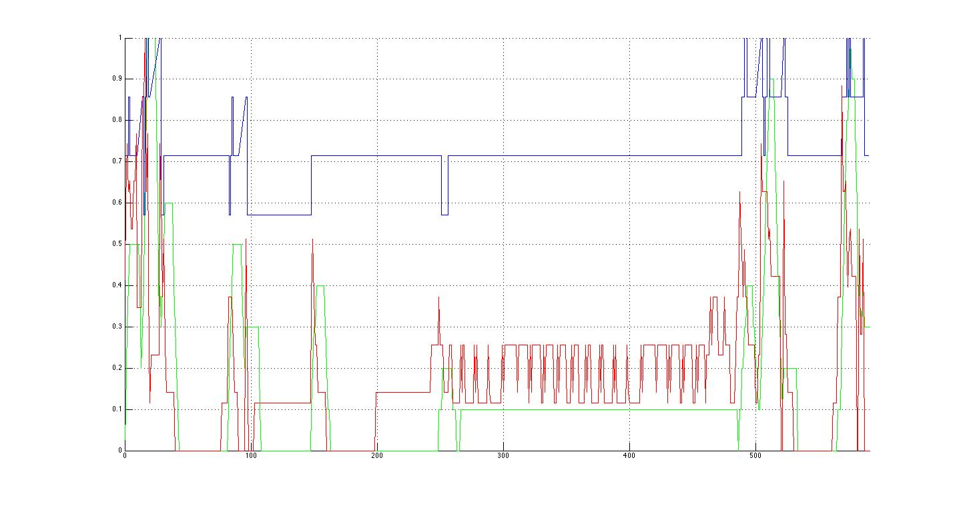
Results for Target Spotted
Cognitive
Temporal
Algorithmic
Land
Report
Flight plan
Monitoring
Notes:
First blue peak is the MM talking to the PS(Area of Interest)
The first green peak is the OP listening to the MM but he is quickly ignored as the MM realizes he needs more info from the PS(target description)
gap between early peaks(MM tells VO the target description first)
MM finally tells the OP the area to search resulting in second set of peaks.
large green peak around 160 - launching the UAV.
Medium green peaks at 260 - putting in the search area(it took awhile to enter, complicated flight plan)
green peaks in the middle are just controlling the UAV, alternating between gui control and direct control.
Blue peaks that come next are due to OP reporting flight completion.
high peak following is the MM reporting to the PS the search completion.
Green peak is landing
Final blue peak is the communication of the target sighting from the VO to the MM to the PS.

Slide 43
Report on last 6+ Months

Slide 44
FVHMS 2014
AAAI Spring Symposium: Formal Verification in Human Machine Systems
3 plenary speakers
Panel discussion: Modeling hurts
13 full paper presentations
9 poster presentations
FVHMS Website
IEEE Transactions on Human-Machine Systems
Special Issue on “Systematic Approaches to HMI - improving resilience, robustness, and stability”

Slide 45
Students and Collaborators
Graduated
T.J. Gledhill (M.S.)
Robert Ivie (B.S.)
Jared Moore (B.S.)
New Students
Emily Lazalde, B.S., 2nd year
Andrew Wallace, B.S., 2nd year
Michael Sharp, B.S., 2nd year
Michael Brodie, M.S., 1st year
Collaborators
Neha Rungta, Researcher, NASA AMES
Richard Stocker, Post-doc, NASA AMES
Mark Holbrook, Researcher, NASA AMES

Slide 46
Outline
New Tools: DiRGs, swim lanes, and plots
We now connect transitions to workload. We also are able to visualize DiRGs.
New Scenarios:
Alice and Bob Sensitivity study
WiSAR flies and lands
WiSAR Battery failure
WiSAR Sighting, battery failure lands
WiSAR Sighting and lands
WiSAR Signal lost
Brahms mapping (BDI): ATM Model
User Study Plan

Slide 47
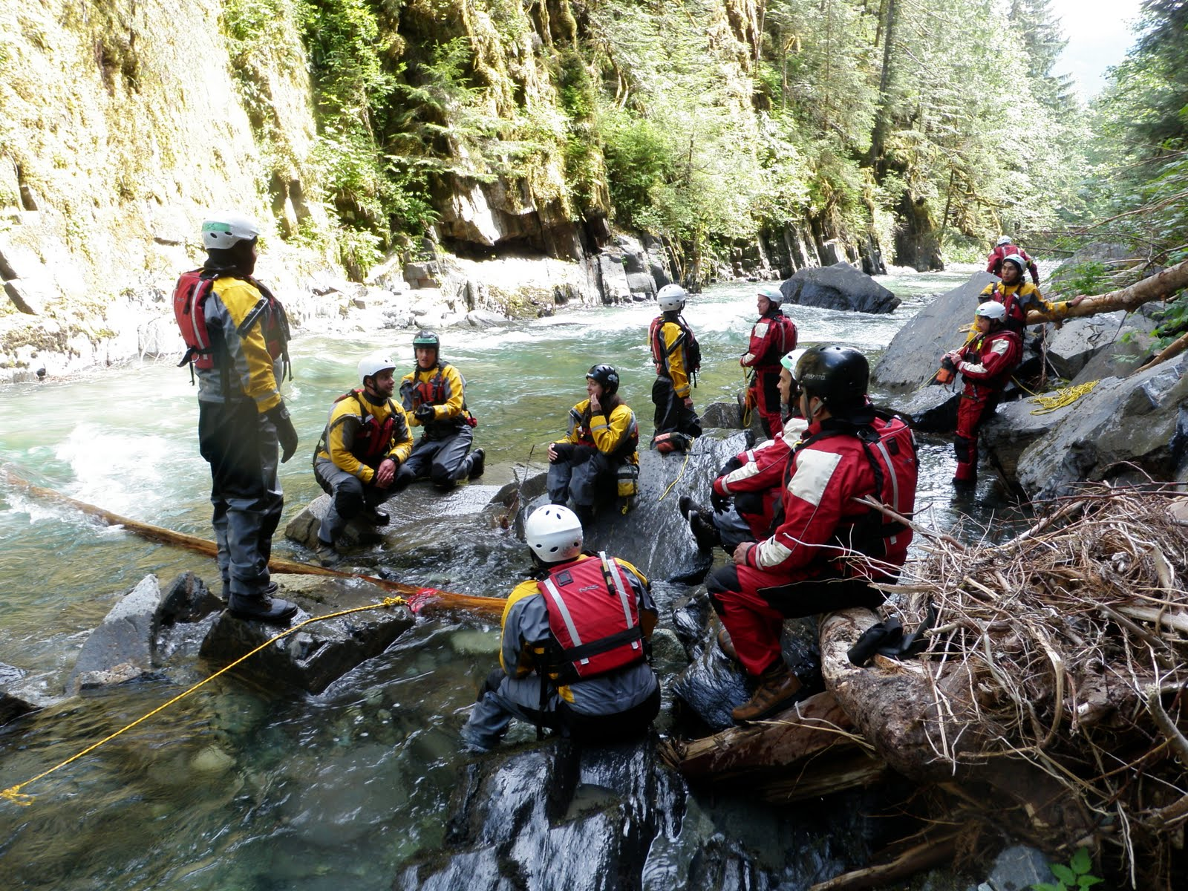
Questions?

